Slide 1
Beyond Back of the Envelope
Yet-Ming Chiang
Ryan Boas

Slide 2
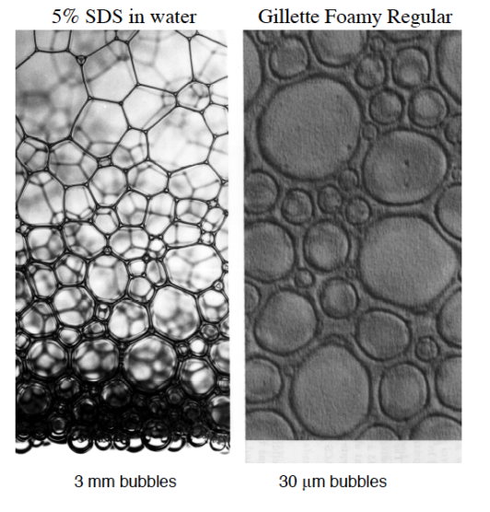
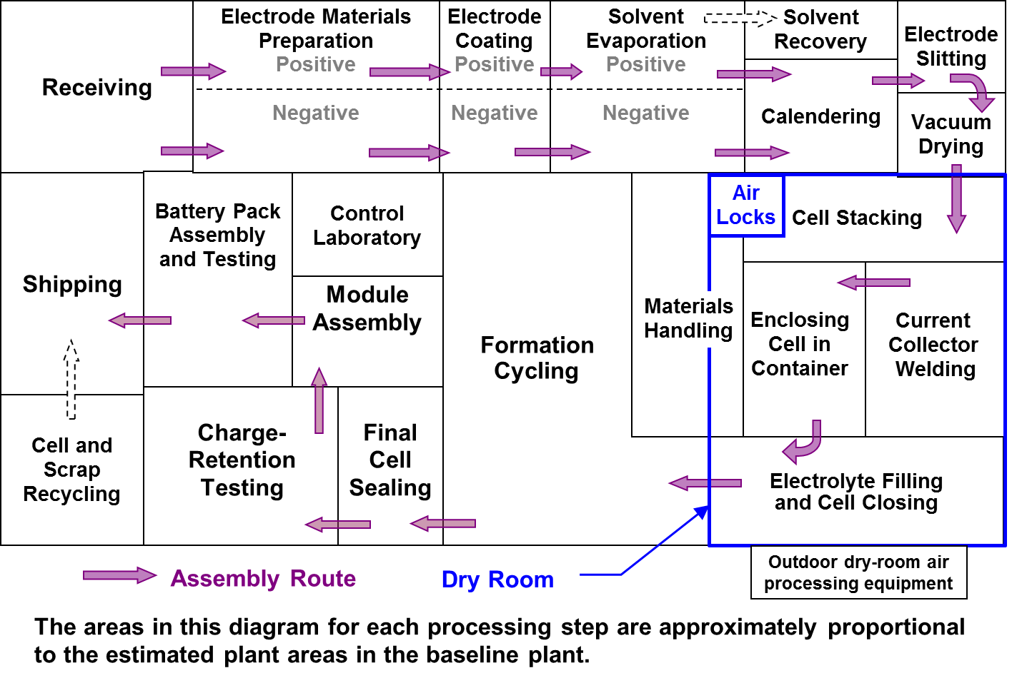
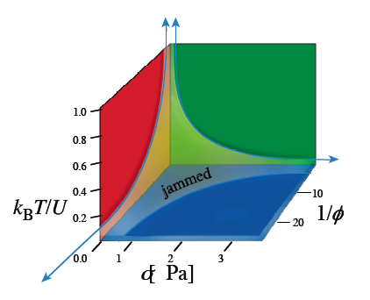
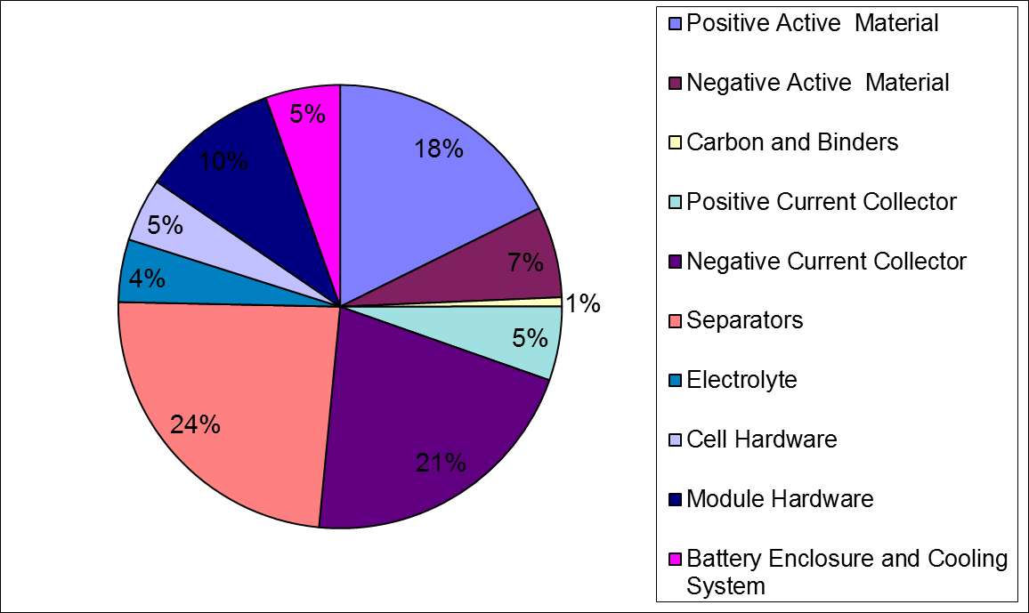
Out of the comfort zone
Research
Business

Slide 3
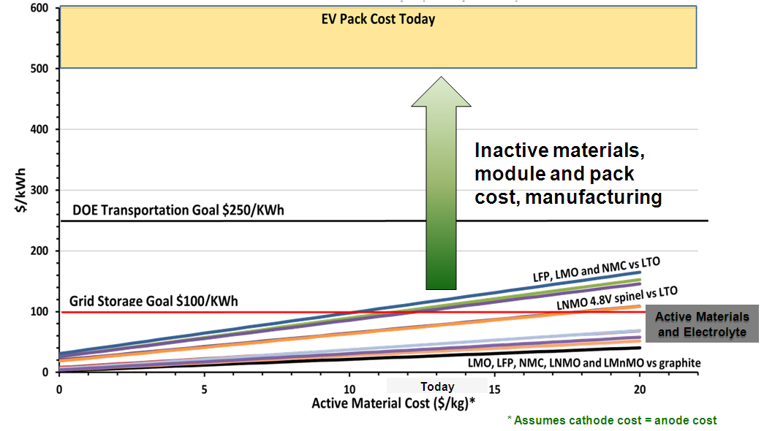
Attacking the Right Problem

Slide 4
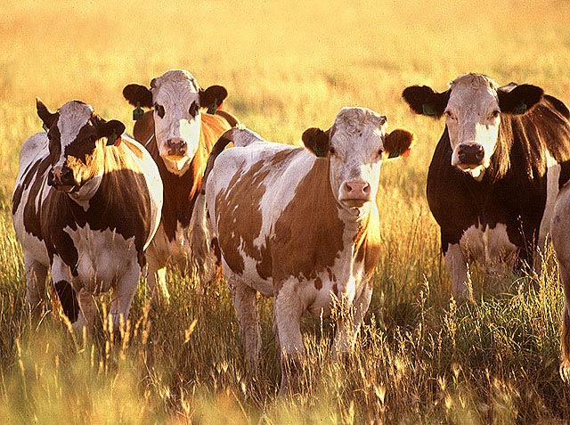

“Thinning the herd”- Dec. 3, 2008
240+ thin film PV companies
One clear success
Note: Public domain image. USDA 5/19/2003

Slide 5
Live and Die By Your Cost Model
Be fluent in the concepts and mechanics of cost modeling
Use cost modeling to avoid the 4 most common pitfalls of technology development
Build your own cost model

Slide 6
Basic concepts

Slide 7
Price – COGS = Gross Margin
Definitions
Price – What the market pays
COGS – Cost of Goods Sold
Materials
+ Depreciation
+ Labor
+ Other
BOM – Bill of Materials
Note: Materials ≠ BOM
COGS

Slide 8
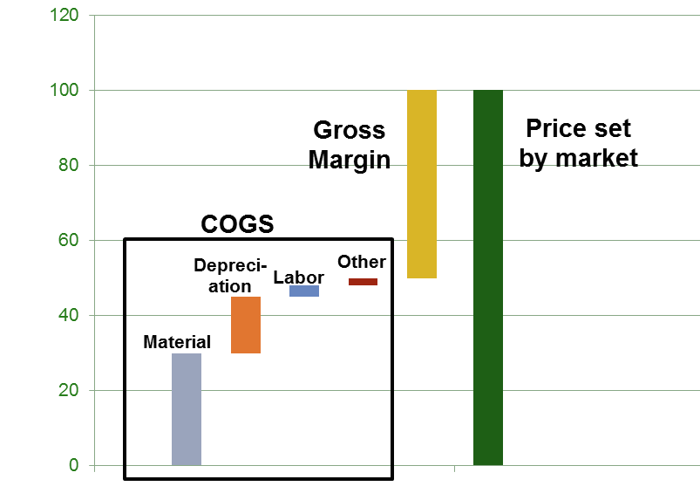
Depreciation = amortized CapEx
$250M
$25M
10 yr Term
25M units
$1
Per-unit
Depreciation
Yearly
Depreciation
Factory &
Equipment
(CapEx)

Slide 9
Integrate Cost & Performance Models
 | Material A | Material B
COGS ($) | $750 | $1,000
Energy (kWh) | 2 | 2
Life (cycles) | 3,000 | 10,000
Life cycle cost ($/kWh) | $0.13 | $0.05
Cost Model
Performance Model
Integration

Slide 10
Top Pitfalls

Slide 11
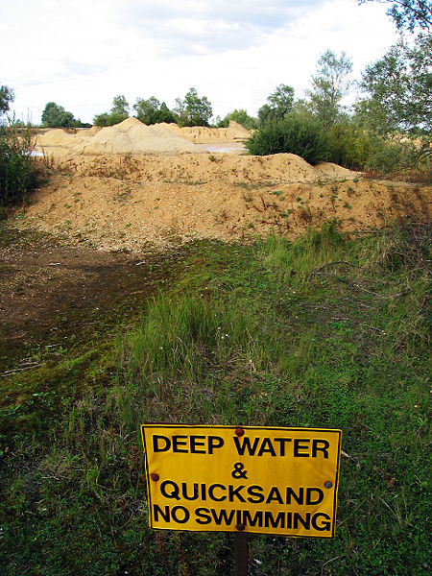
The 4 most common pitfalls of developing technology without a guiding model
Attacking the wrong problem
Misunderstanding state of art and trajectory
Idealizing system costs and manufacturing
Blind to system sensitivities
© Andrew Dunn, 24 September 2005.

Slide 12
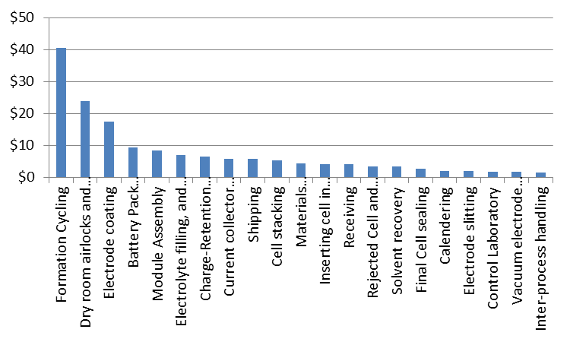
Attacking the Wrong Problem
Focus here.
Not here.
Source: Argonne BatPaC, v1.0. Battery 1 selected with default values.

Slide 13
Misunderstanding Trajectory

Slide 14
Your Position in Trajectory
You fund these losses.

Slide 15
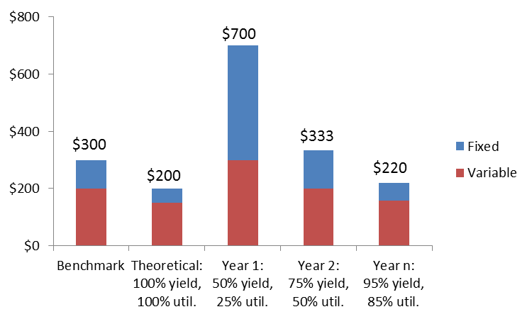
Idealizing: The 100% Fallacy
Where you start
The initial comparison
The long slog

Slide 16
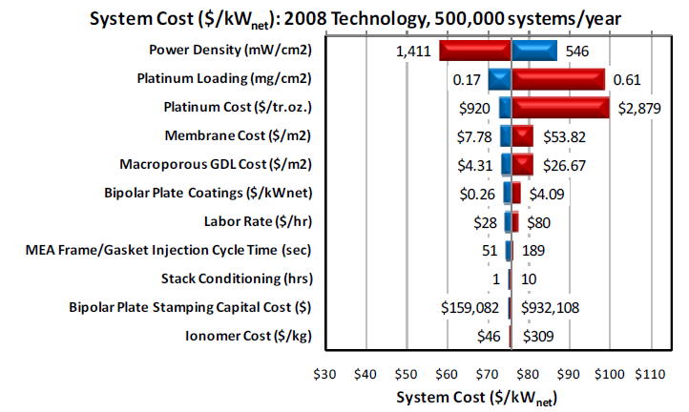
Misunderstanding Sensitivities
HIGH Priority
LOW Priority
Tornado Chart Example for PEM Fuel Cells from: http://www1.eere.energy.gov/hydrogenandfuelcells/pdfs/mass_production_cost_estimation_report.pdf

Slide 17
How to get started

Slide 18
Zeroeth Order – Back of the Envelope
A very simple back of envelope estimate is a great starting point.
Use raw materials costs to provide a rough lower bound on cost
Make optimistic guess of performance using modeling or lab results
Adjust roughly to accommodate balance of systems, yield, margins
Compare with state of the art (via experts, validated models)
Ask outside experts to give you their back-of-the-envelope assessment. Their intuition is highly valuable.

Slide 19
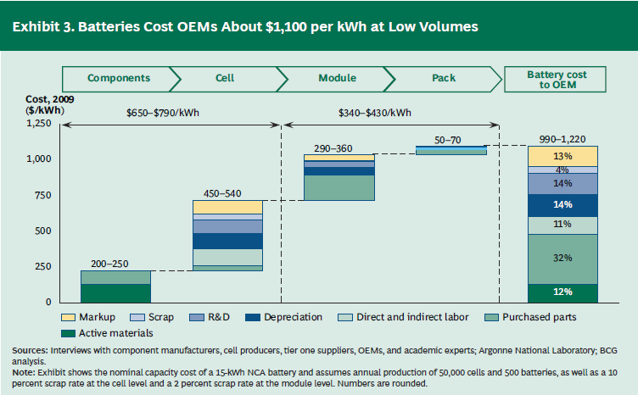
Zeroeth Order – Things you can Google
Source: BCG
Google is a great starting point, but don’t rely solely on reports, which can be erroneous or outdated – validate with experts in the field!

Slide 20
First Order – Develop a base model
A simple, but comprehensive model will be the workhorse for your technology development decisions.
Model the physical parameters of your system
Model performance based on changes to those parameters
Tie design parameters to materials and component costs
Use real cost data from reports or direct supplier research
Take care on volume assumptions
Build a best-effort manufacturing model
Apply industry-standard adjustment factors for balance of systems, yield, and margins
Run a sensitivity analysis to see how design variables affect your key performance metrics
Make sure you know which performance metrics are valued by the market

Slide 21
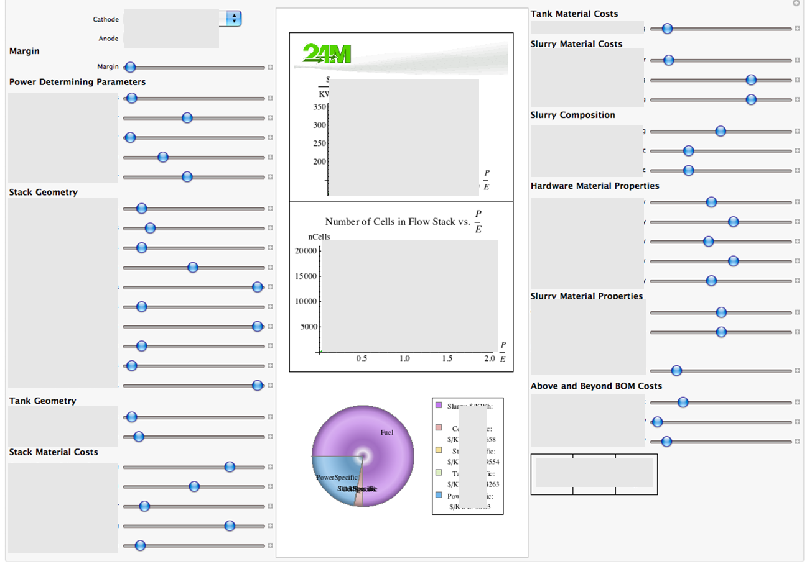
Cost/Performance Model

Slide 22
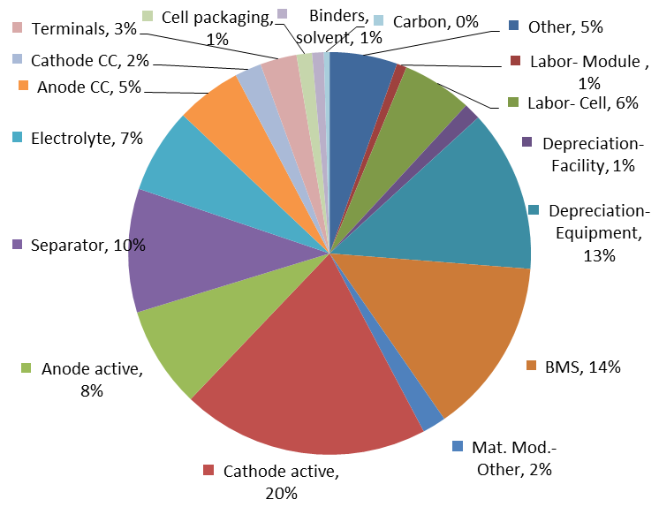

Argonne Battery Model Baseline
http://www.cse.anl.gov/batpac/index.html

Slide 23
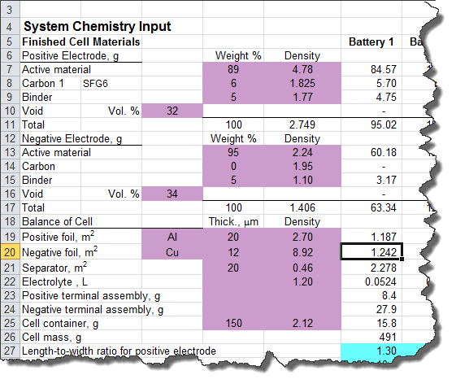
Behind the Charts - Materials

Slide 24
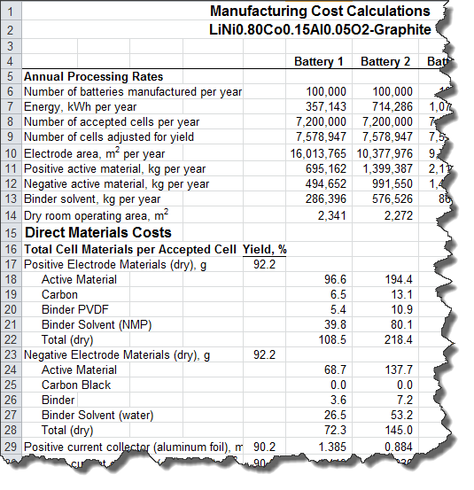
Behind the Charts – Manufacturing

Slide 25
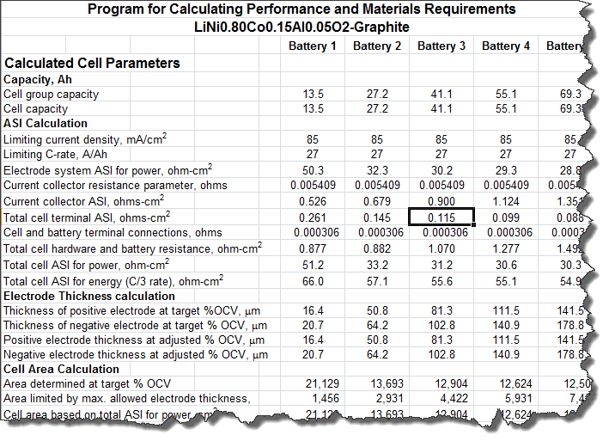
Behind the Charts - Performance

Slide 26
Capex Pareto
Source: Argonne BatPaC, v1.0. Battery 1 selected with default values.

Slide 27
Sensitivity Analysis
D. M. Powell, M. T. Winkler, H. J. Choi, C. B. Simmons, D. B. Needleman and T. Buonassisi, Energy & Environmental Science, DOI:10.1039/C2EE03489A, 2012.

Slide 28
Nth Order – Iterate and Expand
As the need arises, expand your model to include more complexity and detail
Use your model to drive design of experiments and refine the model based on results
Incorporate actual cost data for various projected volumes from specific potential suppliers
Develop internal models for balance of systems, yield, and margins based on actual design, manufacturing, and go-to-market plans.
Expand sensitivity analysis to help evaluate complex design trade-offs
Consider building a robust interface to allow for protected sharing of your model with potential investors, partners, etc.

Slide 29
Know Thy Lingo
BOM (pronounced ‘bom’) vs. COGS
BOM is the bill of materials, applies to a single unit
COGS includes materials, depreciation, labor, other costs and is impacted by yield, utilization
Price vs. cost vs. margin
Price set by market
Cost (COGS) is the full cost to manufacture your product
Margin is what is left to run the rest of the company and make a profit
Yield
(Product that rolls off the mfg line minus damaged product) divided by (product that rolls off the mfg line)
Utilization
The fraction of total factory capacity that was actually used. Total factory output divided by total factory capacity.
Tornado chart
Chart that ranks the relative importance of cost inputs. Tells you what to focus on. Looks like a tornado (kind of).
Pareto chart
Chart that shows individual contributions to cost in a ranked order.

Slide 30
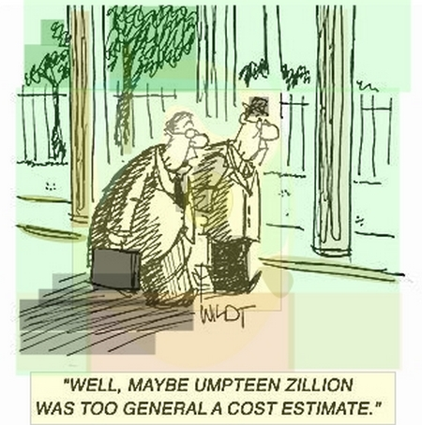
Summary
Quantify industry price and cost trends
Model COGS for your technology
Start early
Develop iteratively with best available information
Be realistic about the progression from today to your future vision

Slide 31
Thank You.
24M Technologies, Inc.
One Kendall Square, Suite B6103
Cambridge, MA 02139
T: (617) 553-1012
F: (617) 553-1018
E: info@24-m.com

